Slide 1
Chapter 9
More on Specification and Data Issues

Slide 2
More on Specification and Data Issues (1 of 20)
Tests for functional form misspecification
One can always test whether explanatory should appear as squares or higher order terms by testing whether such terms can be excluded.
Otherwise, one can use general specification tests such as RESET
Regression specification error test (RESET)
The idea of RESET is to include squares and possibly higher order fitted values in the regression (similarly to the reduced White test).
Test for the exclusion of the y hat terms. If they cannot be excluded, this is evidence for omitted higher order terms and interactions, i.e. for misspecification of functional form.

Slide 3
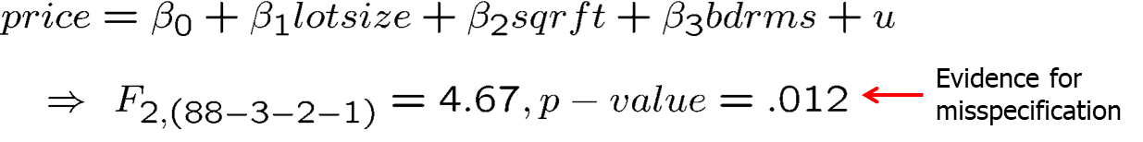
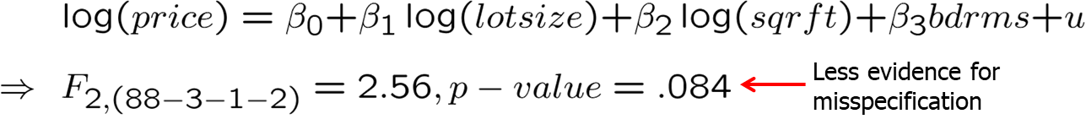
More on Specification and Data Issues (2 of 20)
Example: Housing price equation
Discussion
One may also include higher order terms, which implies complicated interactions and higher order terms of all explanatory variables.
RESET provides little guidance as to where misspecification comes from.

Slide 4
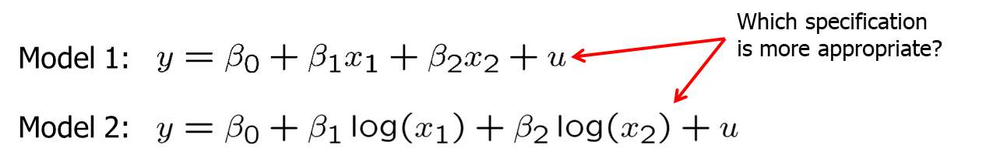
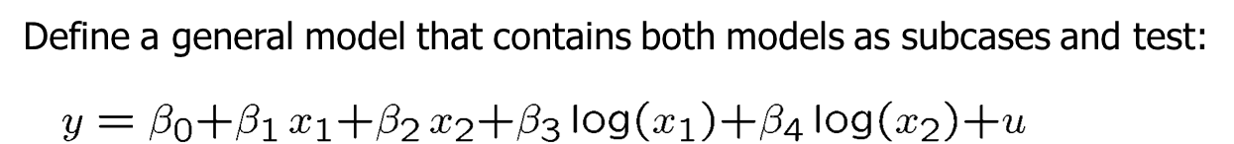
More on Specification and Data Issues (3 of 20)
Testing against nonnested alternatives
Discussion
Can always be done; however, a clear winner need not emerge
Cannot be used if the models differ in their definition of the dependent variable

Slide 5
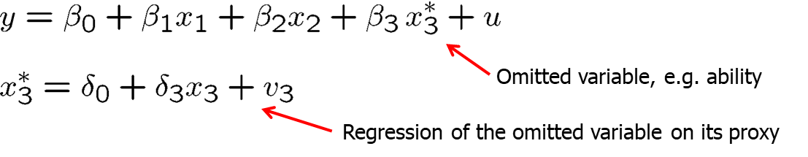
More on Specification and Data Issues (4 of 20)
Using proxy variables for unobserved explanatory variables
Example: Omitted ability in a wage equation
In general, the estimates for the returns to education and experience will be biased because one has omit the unobservable ability variable. Idea: find a proxy variable for ability which is able to control for ability differences between individuals so that the coefficients of the other variables will not be biased. A possible proxy for ability is the IQ score or similar test scores.
General approach to use proxy variables

Slide 6
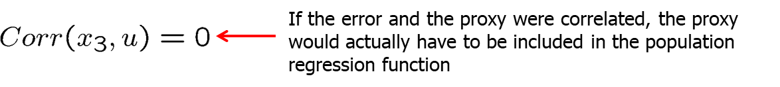
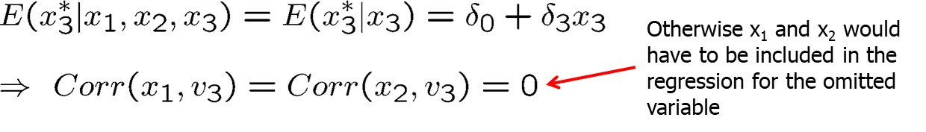
More on Specification and Data Issues (5 of 20)
Assumptions necessary for the proxy variable method to work
The proxy is “just a proxy” for the omitted variable, it does not belong into the population regression, i.e. it is uncorrelated with its error.
The proxy variable is a “good” proxy for the omitted variable, i.e. using other variables in addition will not help to predict the omitted variable.

Slide 7
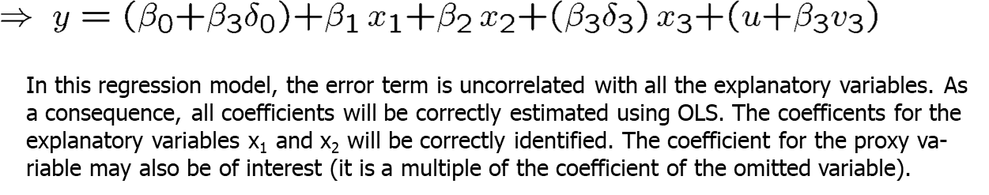
More on Specification and Data Issues (6 of 20)
Under these assumptions, the proxy variable method works:
Discussion of the proxy assumptions in the wage example
Assumption 1: Should be fullfilled as IQ score is not a direct wage determinant; what matters is how able the person proves at work.
Assumption 2: Most of the variation in ability should be explainable by variation in IQ score, leaving only a small rest to educ and exper.

Slide 8
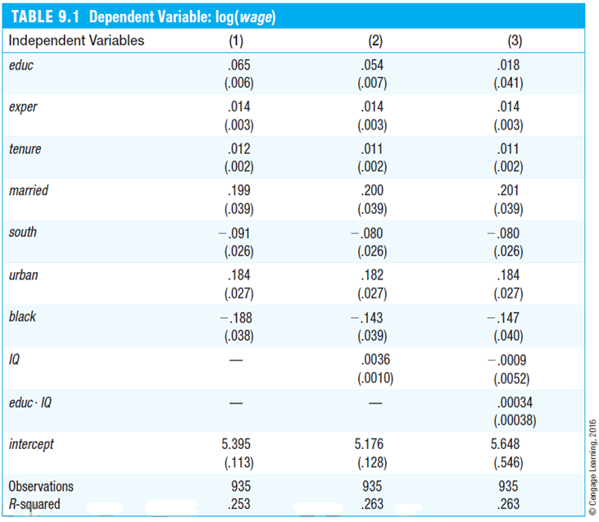
More on Specification and Data Issues (7 of 20)
Independent Variables | (1) | (2) | (3)
educ | .065 (.006) | .054 (.007) | .018 (.041)
exper | .014 (.003) | .014 (.003) | .014 (.003)
tenure | .012 (.002) | .011 (.002) | .011 (.002)
married | .199 (.039) | .200 (.039) | .201 (.039)
south | -.091 (.026) | -.080 (.026) | -.080 (.026)
urban | .184 (.027) | .182 (.027) | .184 (.027)
black | -.188 (.038) | -.143 (.039) | -.147 (.040)
IQ | - | .0036 (.0010) | -.0009 (.0052)
educ*IQ | - | - | .00034 (.00038)
intercept | 5.395 (.113) | 5.176 (.128) | 5.648 (.546)
observations | 935 | 935 | 935
R-squared | .253 | .263 | .263
As expected, the measured return to education decreases if IQ is included as a proxy for unobserved ability.
The coefficient for the proxy suggests that ability differences between indivi-duals are important (e.g. +15 points IQ score are associated with a wage increase of 5.4 percentage points).
Even if IQ score imperfectly soaks up the variation caused by ability, inclu-ding it will at least reduce the bias in the measured return to education.
No significant interaction effect between ability and education.

Slide 9
More on Specification and Data Issues (8 of 20)
Using lagged dependent variables as proxy variables
In many cases, omitted unobserved factors may be proxied by the value of the dependent variable from an earlier time period.
Example: City crime rates
Including the past crime rate will at least partly control for the many omitted factors that also determine the crime rate in a given year.
Another way to interpret this equation is that one compares cities which had the same crime rate last year; this avoids comparing cities that differ very much in unobserved crime factors.

Slide 10
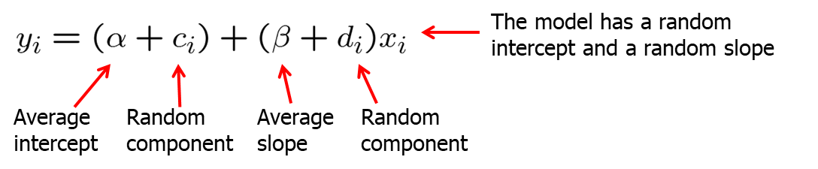
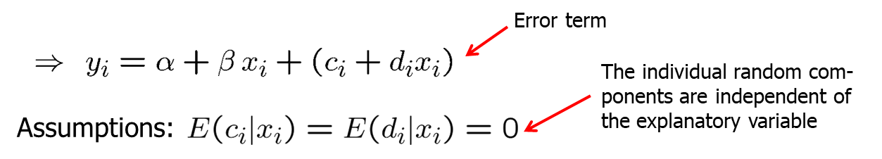
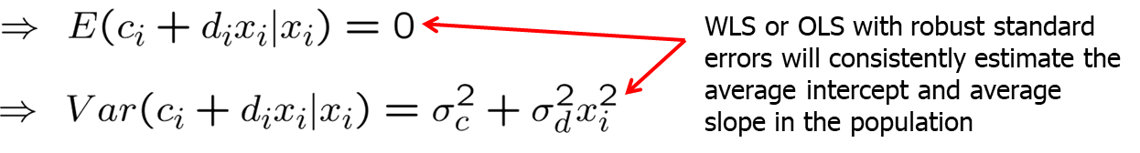
More on Specification and Data Issues (9 of 20)
Models with random slopes (= random coefficient models)

Slide 11
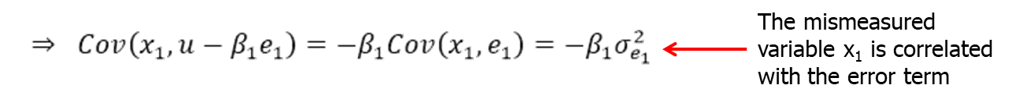
More on Specification and Data Issues (10 of 20)
Measurement error in an explanatory variable

Slide 12
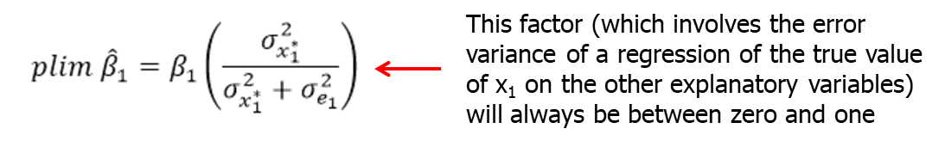
More on Specification and Data Issues (11 of 20)
Consequences of measurement error in an explanatory variable
Under the classical errors-in-variables assumption, OLS is biased and inconsistent because the mismeasured variable is endogenous.
One can show that the inconsistency is of the following form:
The effect of the mismeasured variable suffers from attenuation bias, i.e. the magnitude of the effect will be attenuated towards zero.
In addition, the effects of the other explanatory variables will be biased

Slide 13
More on Specification and Data Issues (12 of 20)
Missing data and nonrandom samples
Missing data as sample selection
Missing data is a special case of sample selection (= nonrandom sampling) as the observations with missing information cannot be used.
If the sample selection is based on independent variables there is no problem as a regression conditions on the independent variables.
In general, sample selection is no problem if it is uncorrelated with the error term of a regression (= exogenous sample selection).
Sample selection is a problem, if it is based on the dependent variable or on the error term (= endogenous sample selection).

Slide 14
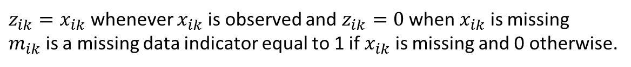
More on Specification and Data Issues (13 of 20)
The Missing Indicator Method (MIM)
Suppose we are missing some information on an explanatory variable
MIM creates two new variables:

Slide 15

More on Specification and Data Issues (14 of 20)
Limitations of the Missing Indicator Method
Unfortunately, the MIM only has good statistical properties under strong assumptions that are unlikely to hold in practice.

Slide 16
More on Specification and Data Issues (15 of 20)
Example for exogenous sample selection
If the sample was nonrandom in the way that certain age groups, income groups, or household sizes were over- or undersampled, this is not a problem for the regression because it examines the savings for subgroups defined by income, age, and hh-size. The distribution of subgroups does not matter.
Example for endogenous sample selection
If the sample is nonrandom in the way individuals refuse to take part in the sample survey if their wealth is particularly high or low, this will bias the regression results because these individuals may be systematically different from those who do not refuse to take part in the sample survey.

Slide 17
More on Specification and Data Issues (16 of 20)
Interpreting the meaning of Missing at Random (MAR)
The term Missing at Random (MAR) means that the missingness is unrelated to the unobserved error u , but it is related to the explanatory variables ( x₁,...,x_{k}).
Missing Completely at Random (MCAR) means that missingness is unrelated to both u and x₁,...,x_{k}.

Slide 18
More on Specification and Data Issues (17 of 20)
Outliers and influential observations
Extreme values and outliers may be a particular problem for OLS because the method is based on squaring deviations.
If outliers are the result of mistakes that occured when keying in the data, one should just discard the affected observations.
If outliers are the result of the data generating process, the decision whether to discard the outliers is not so easy.
Example: R&D intensity and firm size

Slide 19
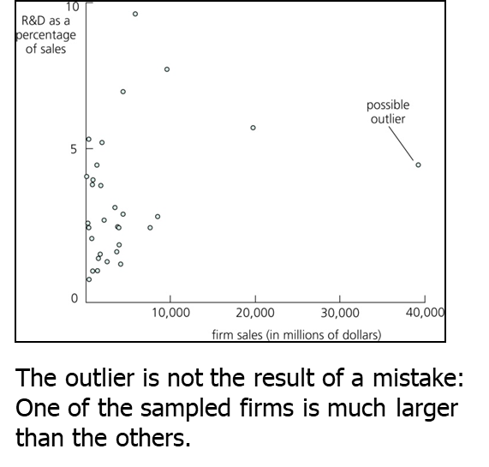
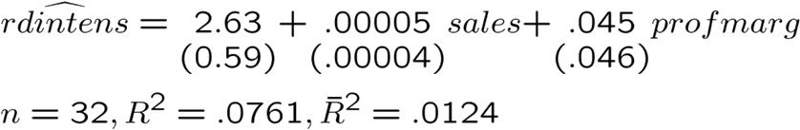
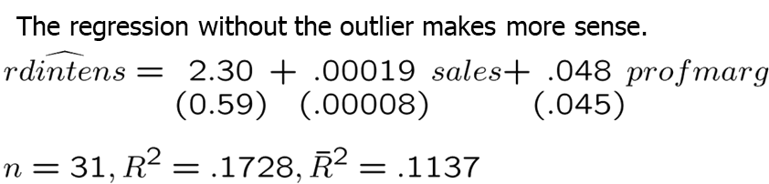
More on Specification and Data Issues (18 of 20)
Example: R&D intensity and firm size (cont.)

Slide 20
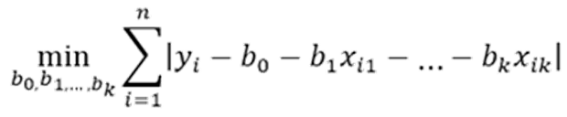
More on Specification and Data Issues (19 of 20)
Least absolute deviations estimation (LAD)
The least absolute deviations estimator minimizes the sum of absolute deviations (instead of the sum of squared deviations, i.e. OLS)
It may be more robust to outliers as deviations are not squared.
The least absolute deviations estimator estimates the parameters of the conditional median (instead of the conditional mean with OLS).
The least absolute deviations estimator is a special case of quantile regression, which estimates parameters of conditional quantiles.

